Slide 1


Introduction to Python
Noble Xavier

Slide 2
Sequence Operations
Concatenation
Repetition
Membership testing
Slicing
Indexing

Slide 3
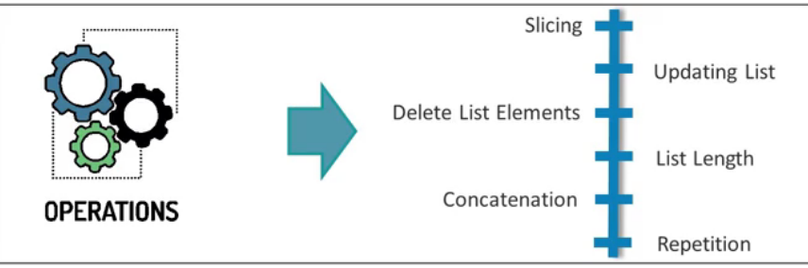
List

Slide 4
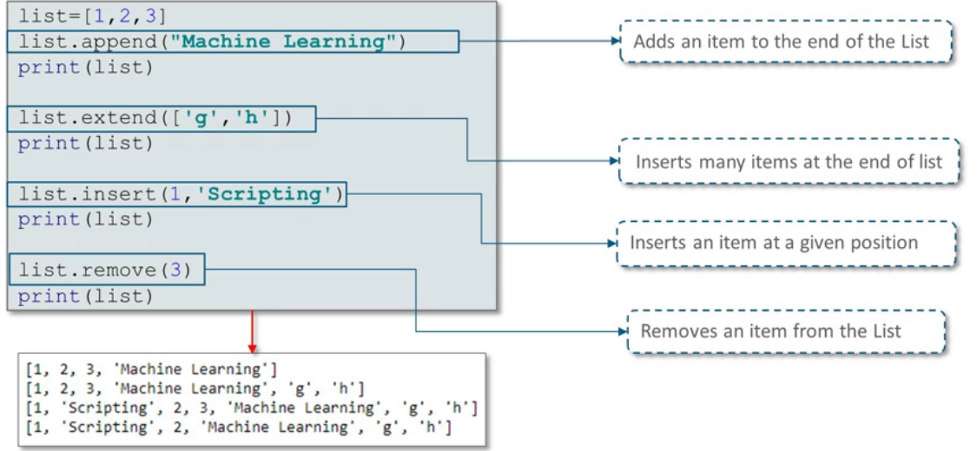
List Operations

Slide 5
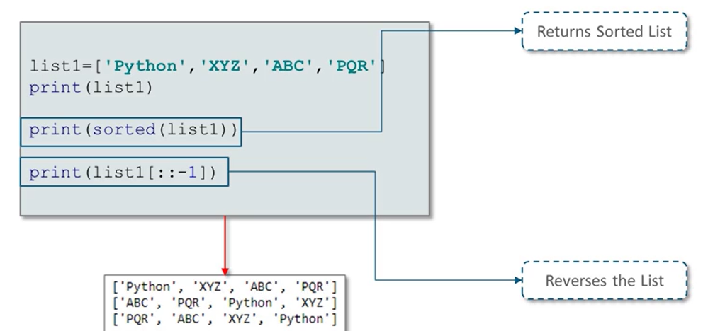
List Operations

Slide 6
